Slide 1





All About Me
Year 7 Health
Lesson 8
2024

Slide 2

In the first 5 minutes of each lesson you will complete your revision page, you will find these throughout your booklet.
The revision page consists of three questions. It will need to be completed in detail. One word answers will not be accepted.
The three questions :
What two concepts or ideas did I learn in class last week?
What did I find interesting about last week’s lesson? Provide a specific example.
Any questions or new words you have learnt?
The teacher will go over this each lesson with you to see what you have learnt. It is a great way for you to revisit content and test your memory.
Notes:
Pg37

Slide 3

Assessment Task 2: Resilience
Due: week 9
Assessment Task 2 – Resilience
Part A – Resilience and Goal Setting
Part B – Scenarios
Part C - Reflection
Notes:
Use this class time to complete Assessment Task 2

Slide 4
All About Me
Year 7 Health
Lesson 9
2024

Slide 5

Hook: Goal setting review (pg.38)
In week 7 you set a SMART goal for yourself to achieve by the end of term.
Revisit your goal and answer the following questions:
    What was your goal?
    Did you achieve your goal?
        If no, why not and how do you feel? How could you change it to make it more achievable?
        If yes, what steps did you take to achieve it and how do you feel?
    Did you face any challenges?
    Set yourself a new SMART goal. Make sure it is…
        Specific
        Measurable
        Action-orientated
        Realistic
        Timely
Notes:
Review the goal that students set in week 7.

Slide 6
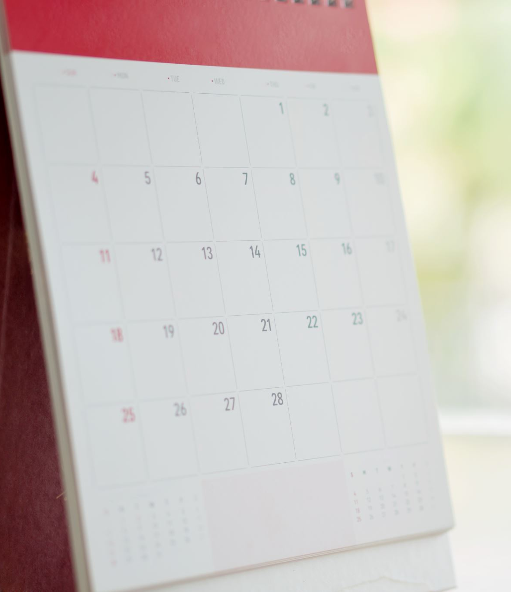
Activity 1:
Getting ready for next term
Next term you will be using interactive PDF’s as your in class work booklet.
Today we need to:
  Download Adobe Reader to your device.
  Download Term 2 workbook.
  Create a Health folder on your device.
Each term in Health for year’s 7-10 you will use an interactive PDF so it is important that you ask questions if you are unsure of this process.
Notes:
Allow at least 20 minutes at the start of this lesson to work through downloading adobe and the next Ebook. This is to ensure that ALL students are ready to go in week 1, term 2.

Slide 7
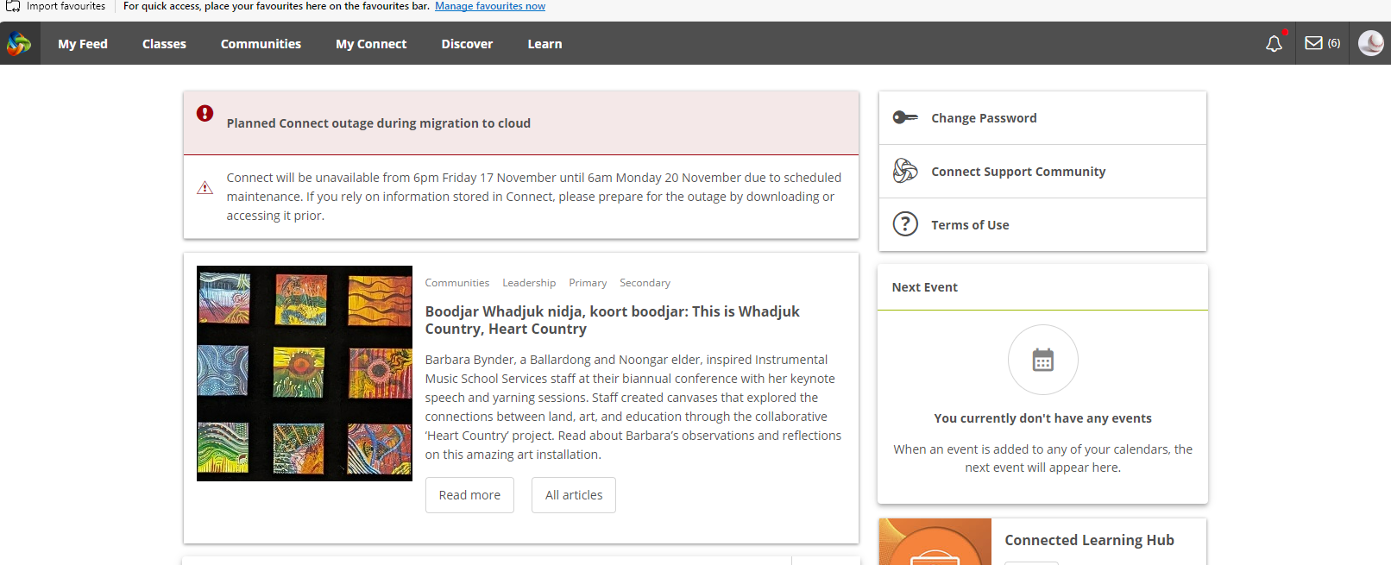
Step 1: Access Student Sharepoint
Log into Connect.
Open your emails by clicking the envelope in the top right corner.

Slide 8
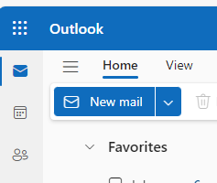
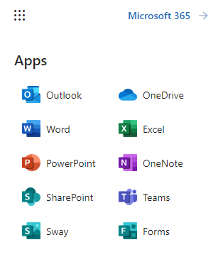
Step 1: Access Student Sharepoint
Once in Outlook, click the square grid in the top left corner.
Click SharePoint.

Slide 9
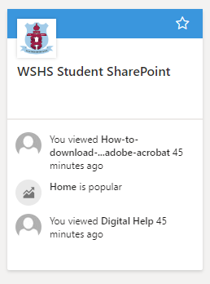
Step 1: Access Student SHarepoint
Open WSHS Student SharePoint.

Slide 10
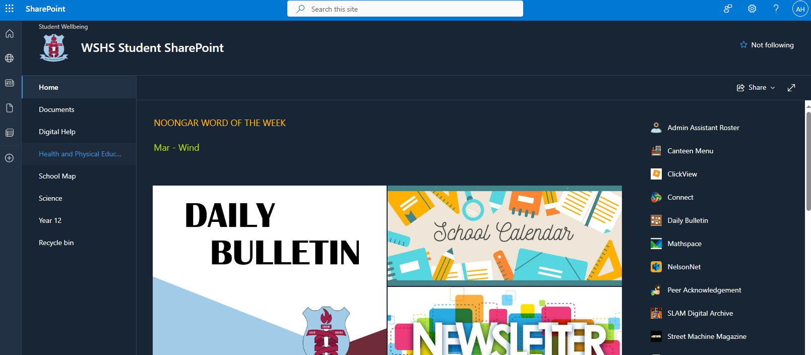
Step 1: Access Student SHarepoint
Choose ‘Digital Help’ from the left column.

Slide 11
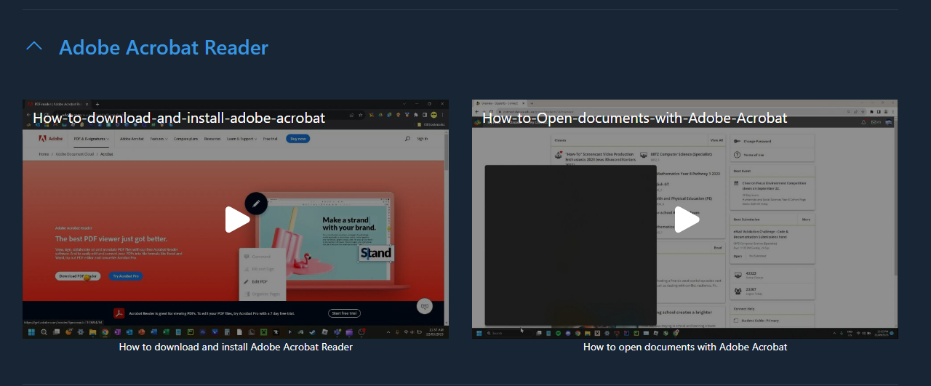
Step 2:
Download Adobe ACROBAT READER
On the Digital Help SharePoint page, you will be able to find and access a variety of videos with help on how to use a range of different programs.
Scroll to the section on ‘Adobe Acrobat Reader’ (it will be at the bottom).
Watch the video ‘how to
download and install adobe
acrobat’ as a class and follow
the instructions on how to
download to your device.
Leave this page open in your
browser to revisit for Step 4.
Notes:
Digital Help
Digital Help (sharepoint.com)

Slide 12
Step 3: Download Student E-book
Next you need to download your Student E-Book for Term 2 from Connect.
  Go to your Health Connect Class.
  Follow your teachers' instructions on where to find your workbook.
  Create a new folder on your device’s desktop called ‘Year 7 Health 2024.’
  Download the E-Book and save it to this new folder you have created.
      If it asks for a password, ask your teacher.
Notes:
Instruct students on where to find the workbook based on where you upload it – Library or Content section?

Slide 13
Step 4: Open your E-book in Adobe
Go back to the Student SharePoint - Digital Help page.
Watch the video ‘how to open documents with Adobe Acrobat’ and follow the instructions.
Alternatively:
  Open the Adobe Acrobat app on your device.
  Click File – open.
  Open your workbook from the folder you
  just created and saved it into.
  Ask your teacher for the password.
  Add your name and your teachers name to
  the front.
  Save your work.
  Re-open to check that it saved your edits.

Slide 14
Assessment Task 2: Resilience
Reminder:
Assessment Task 2 – Resilience
Due: 11:30pm tonight
DUE TODAY
Notes:
Use this time to complete Assessment Task 2. Adjust to whenever you would like the assignment due.

